Slide 1
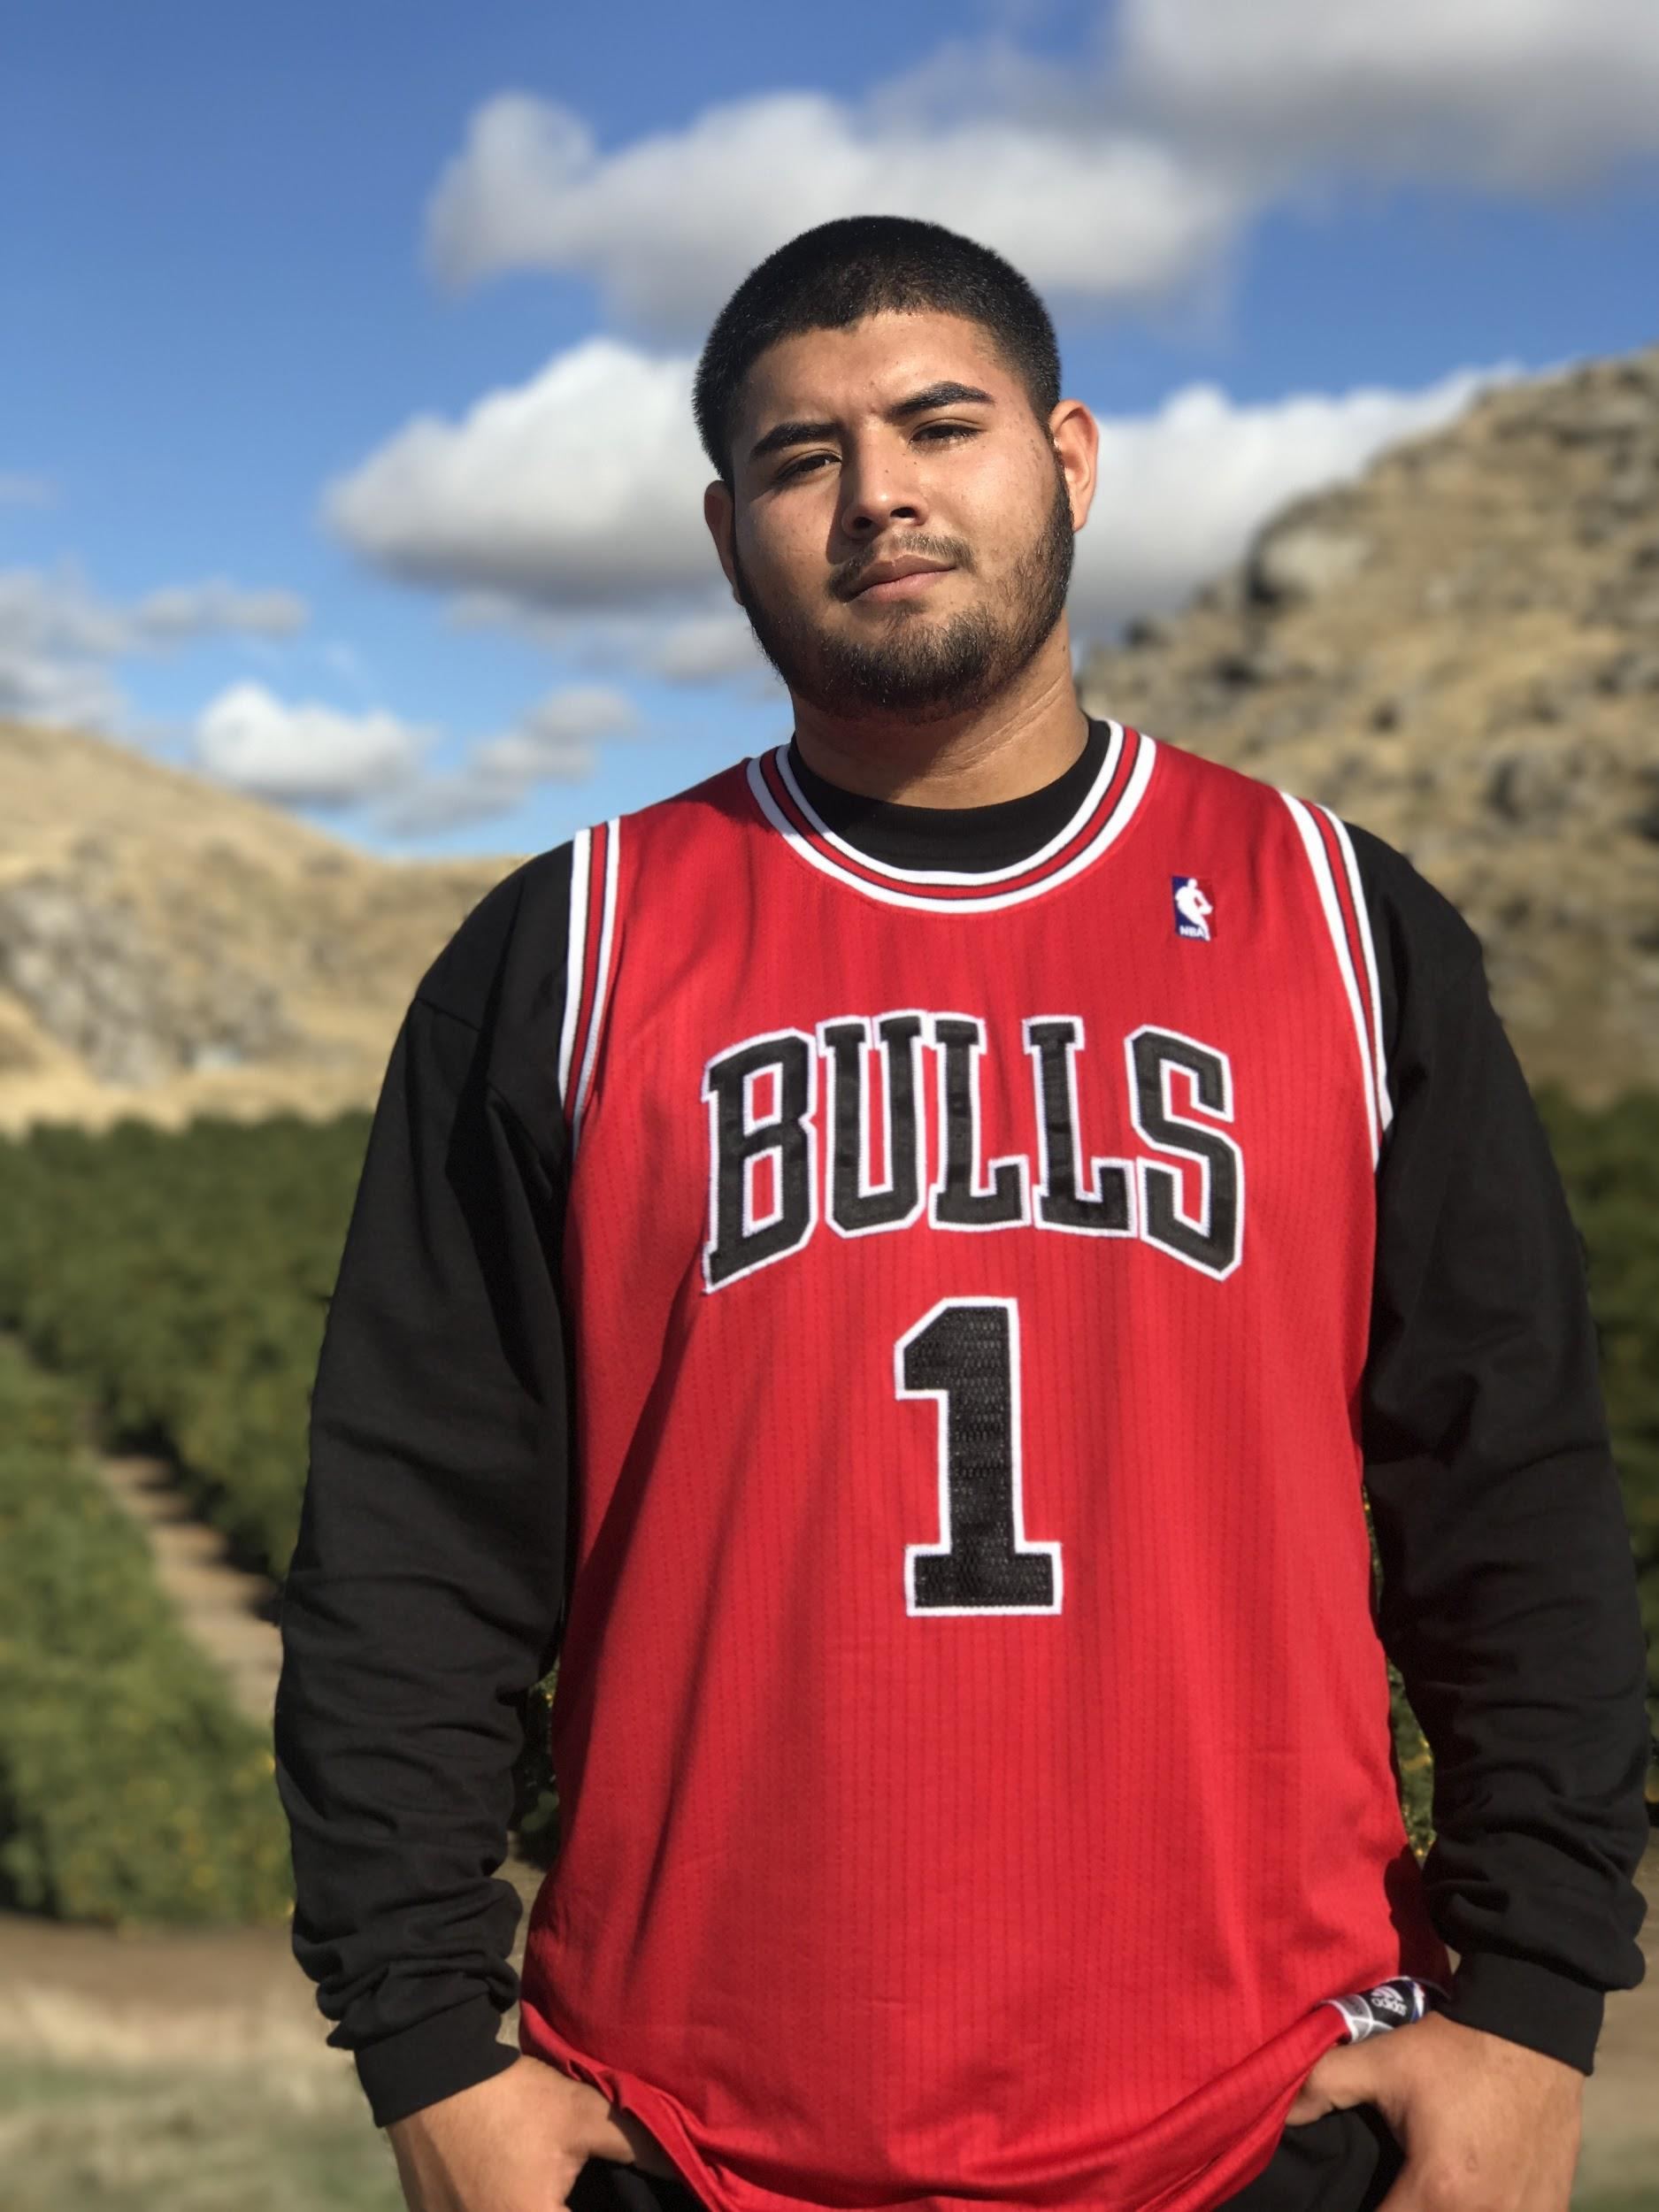
Mario Medina-Duarte

Slide 2
About Me
Birthplace- Born in Culiacan Sinaloa raised in Lindsay, Ca
Siblings- Oldest of five (all boys)
Age- 18
D.O.B- December 24, 1998

Slide 3
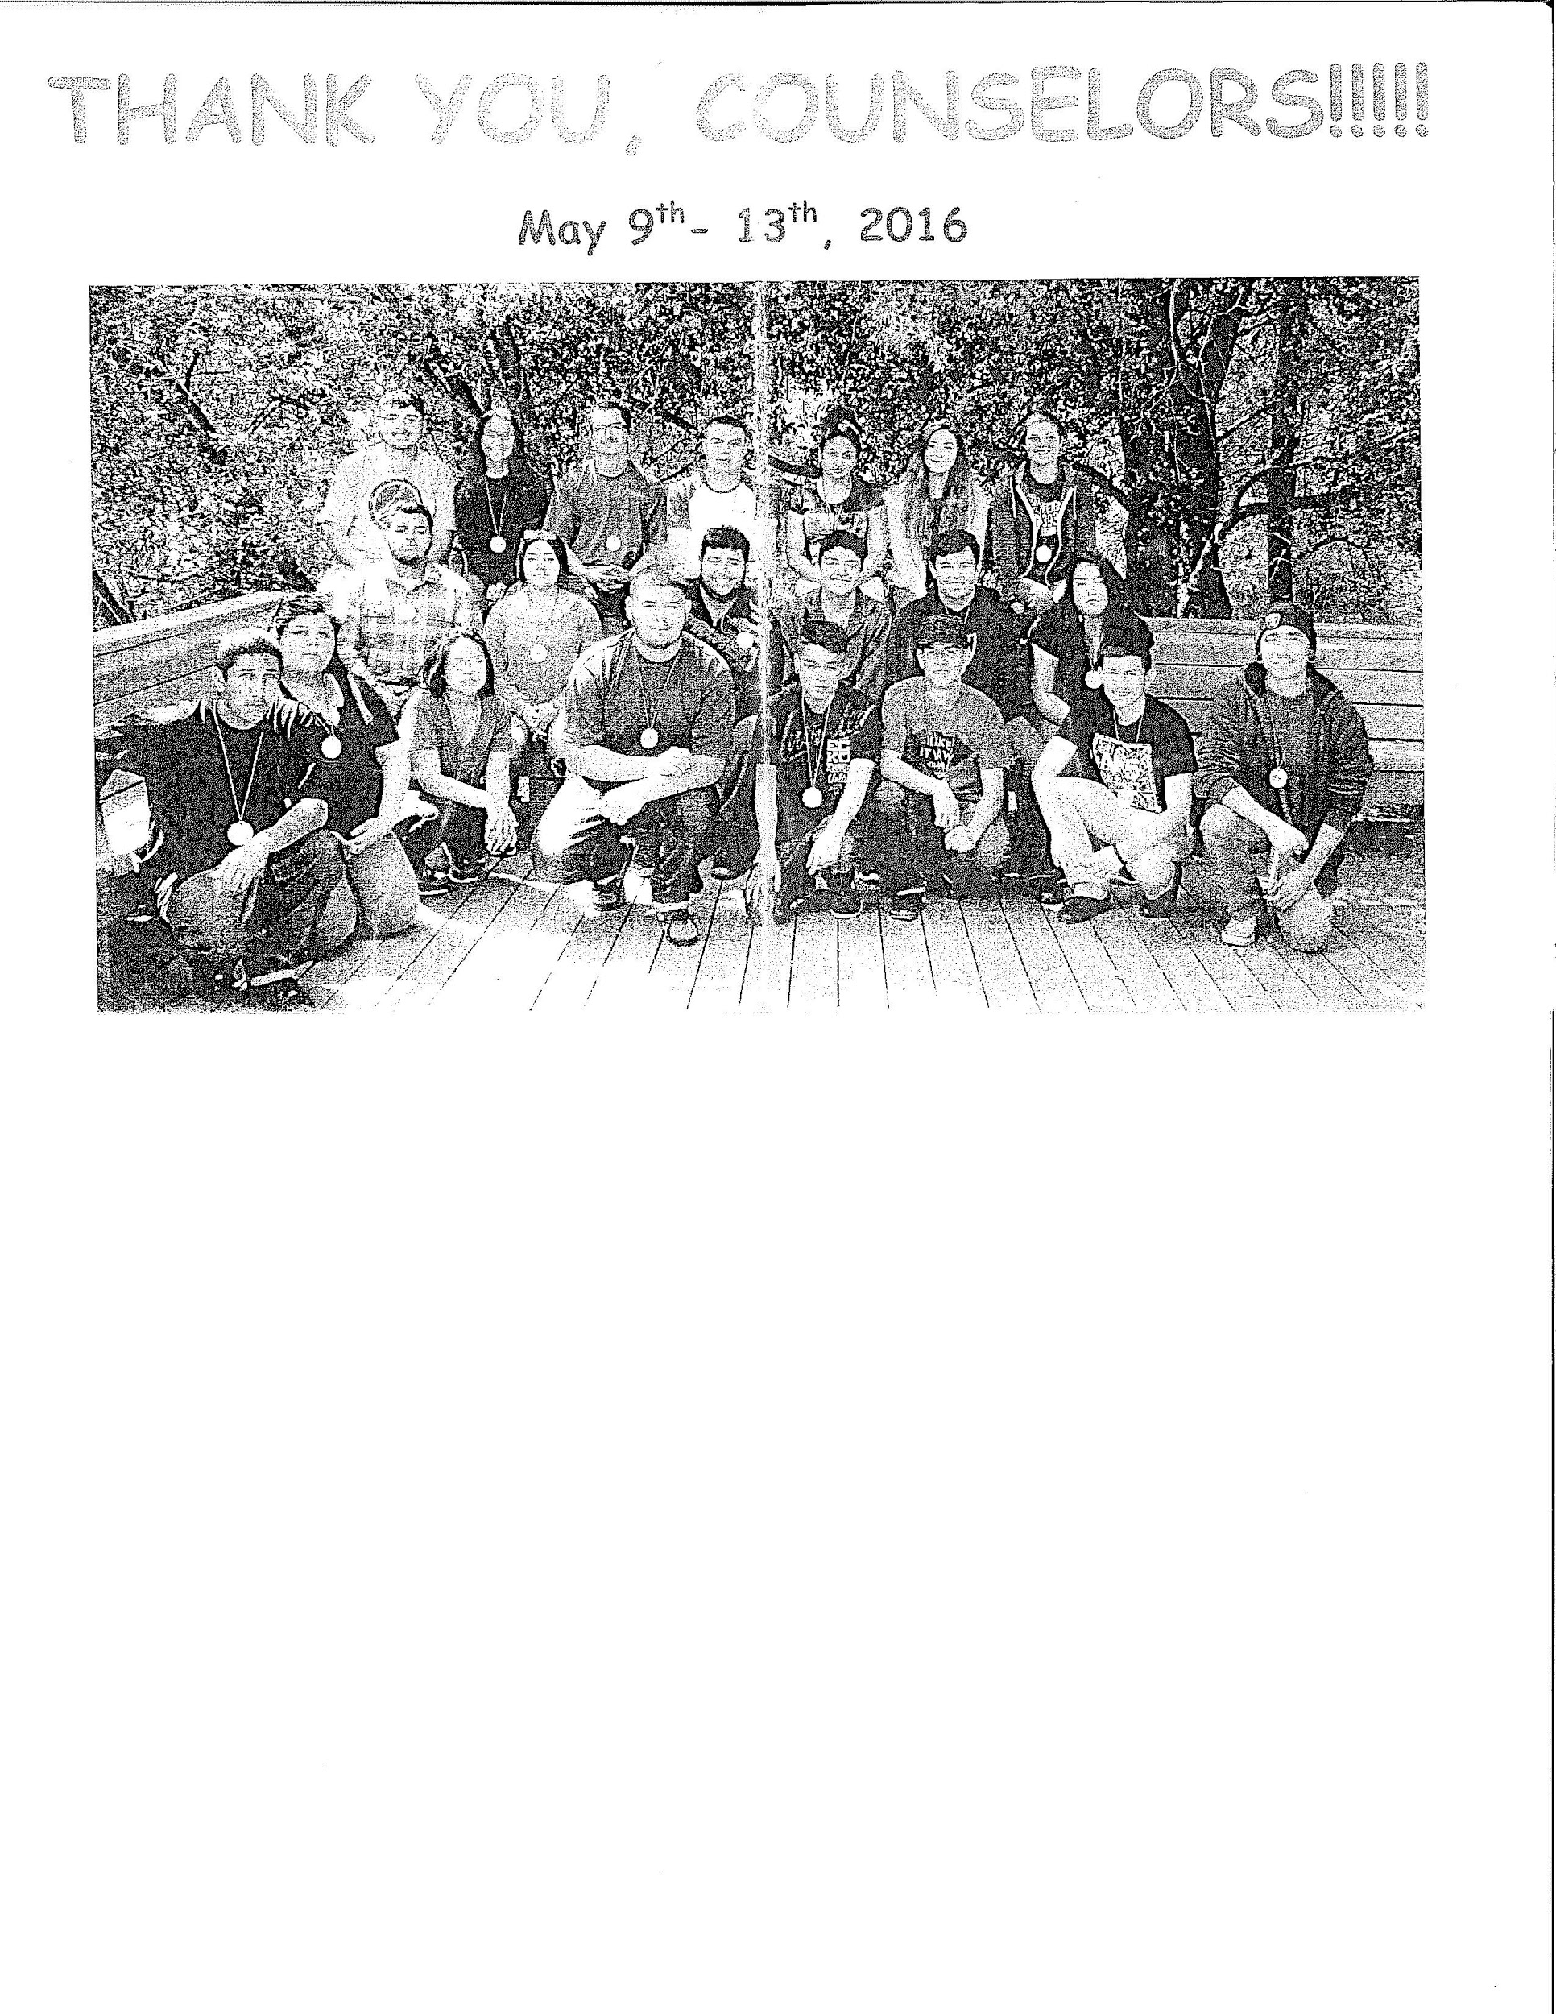
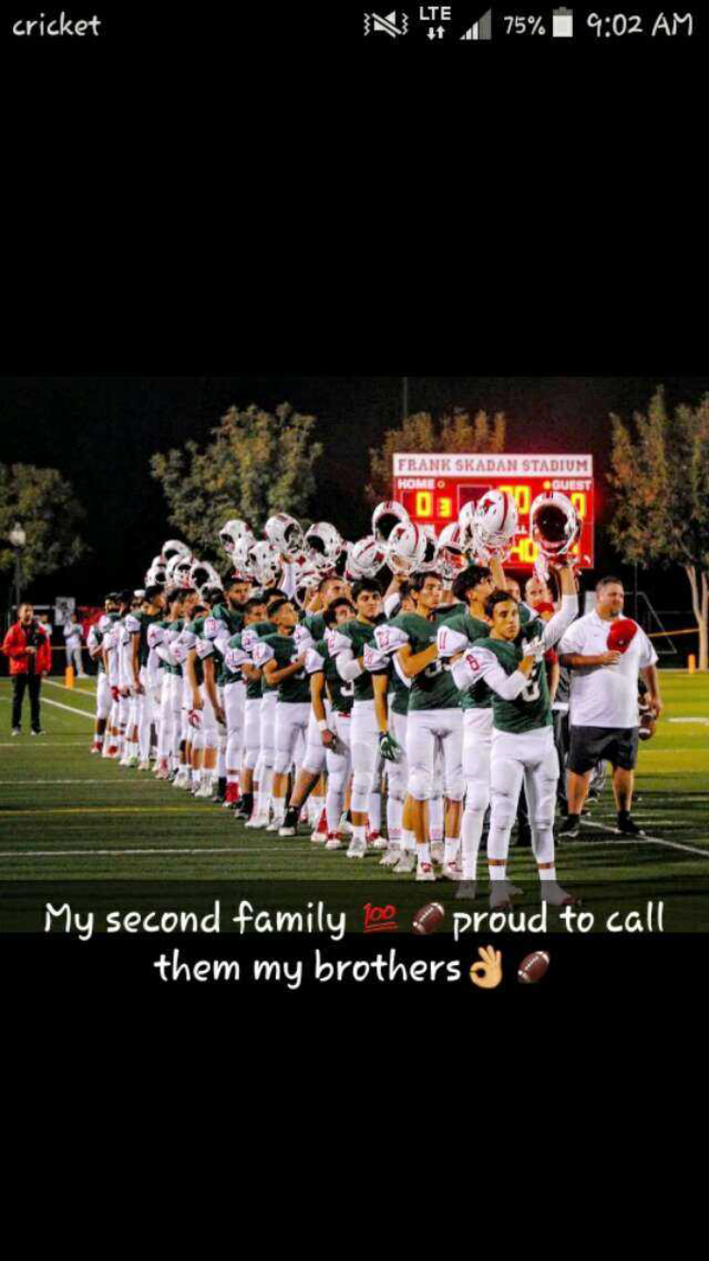
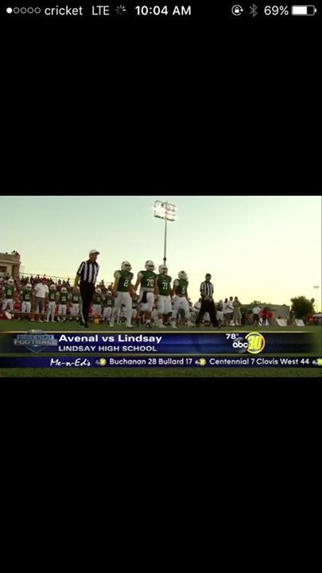
High School Experience
Clubs- Red Zone - Football - wrestling
Success- transferring from jj’s to LHS
Challenges- Homework done online
Work better on my own
Enjoined being a Cardinal not just as a student but also as an athlete
scicon

Slide 4
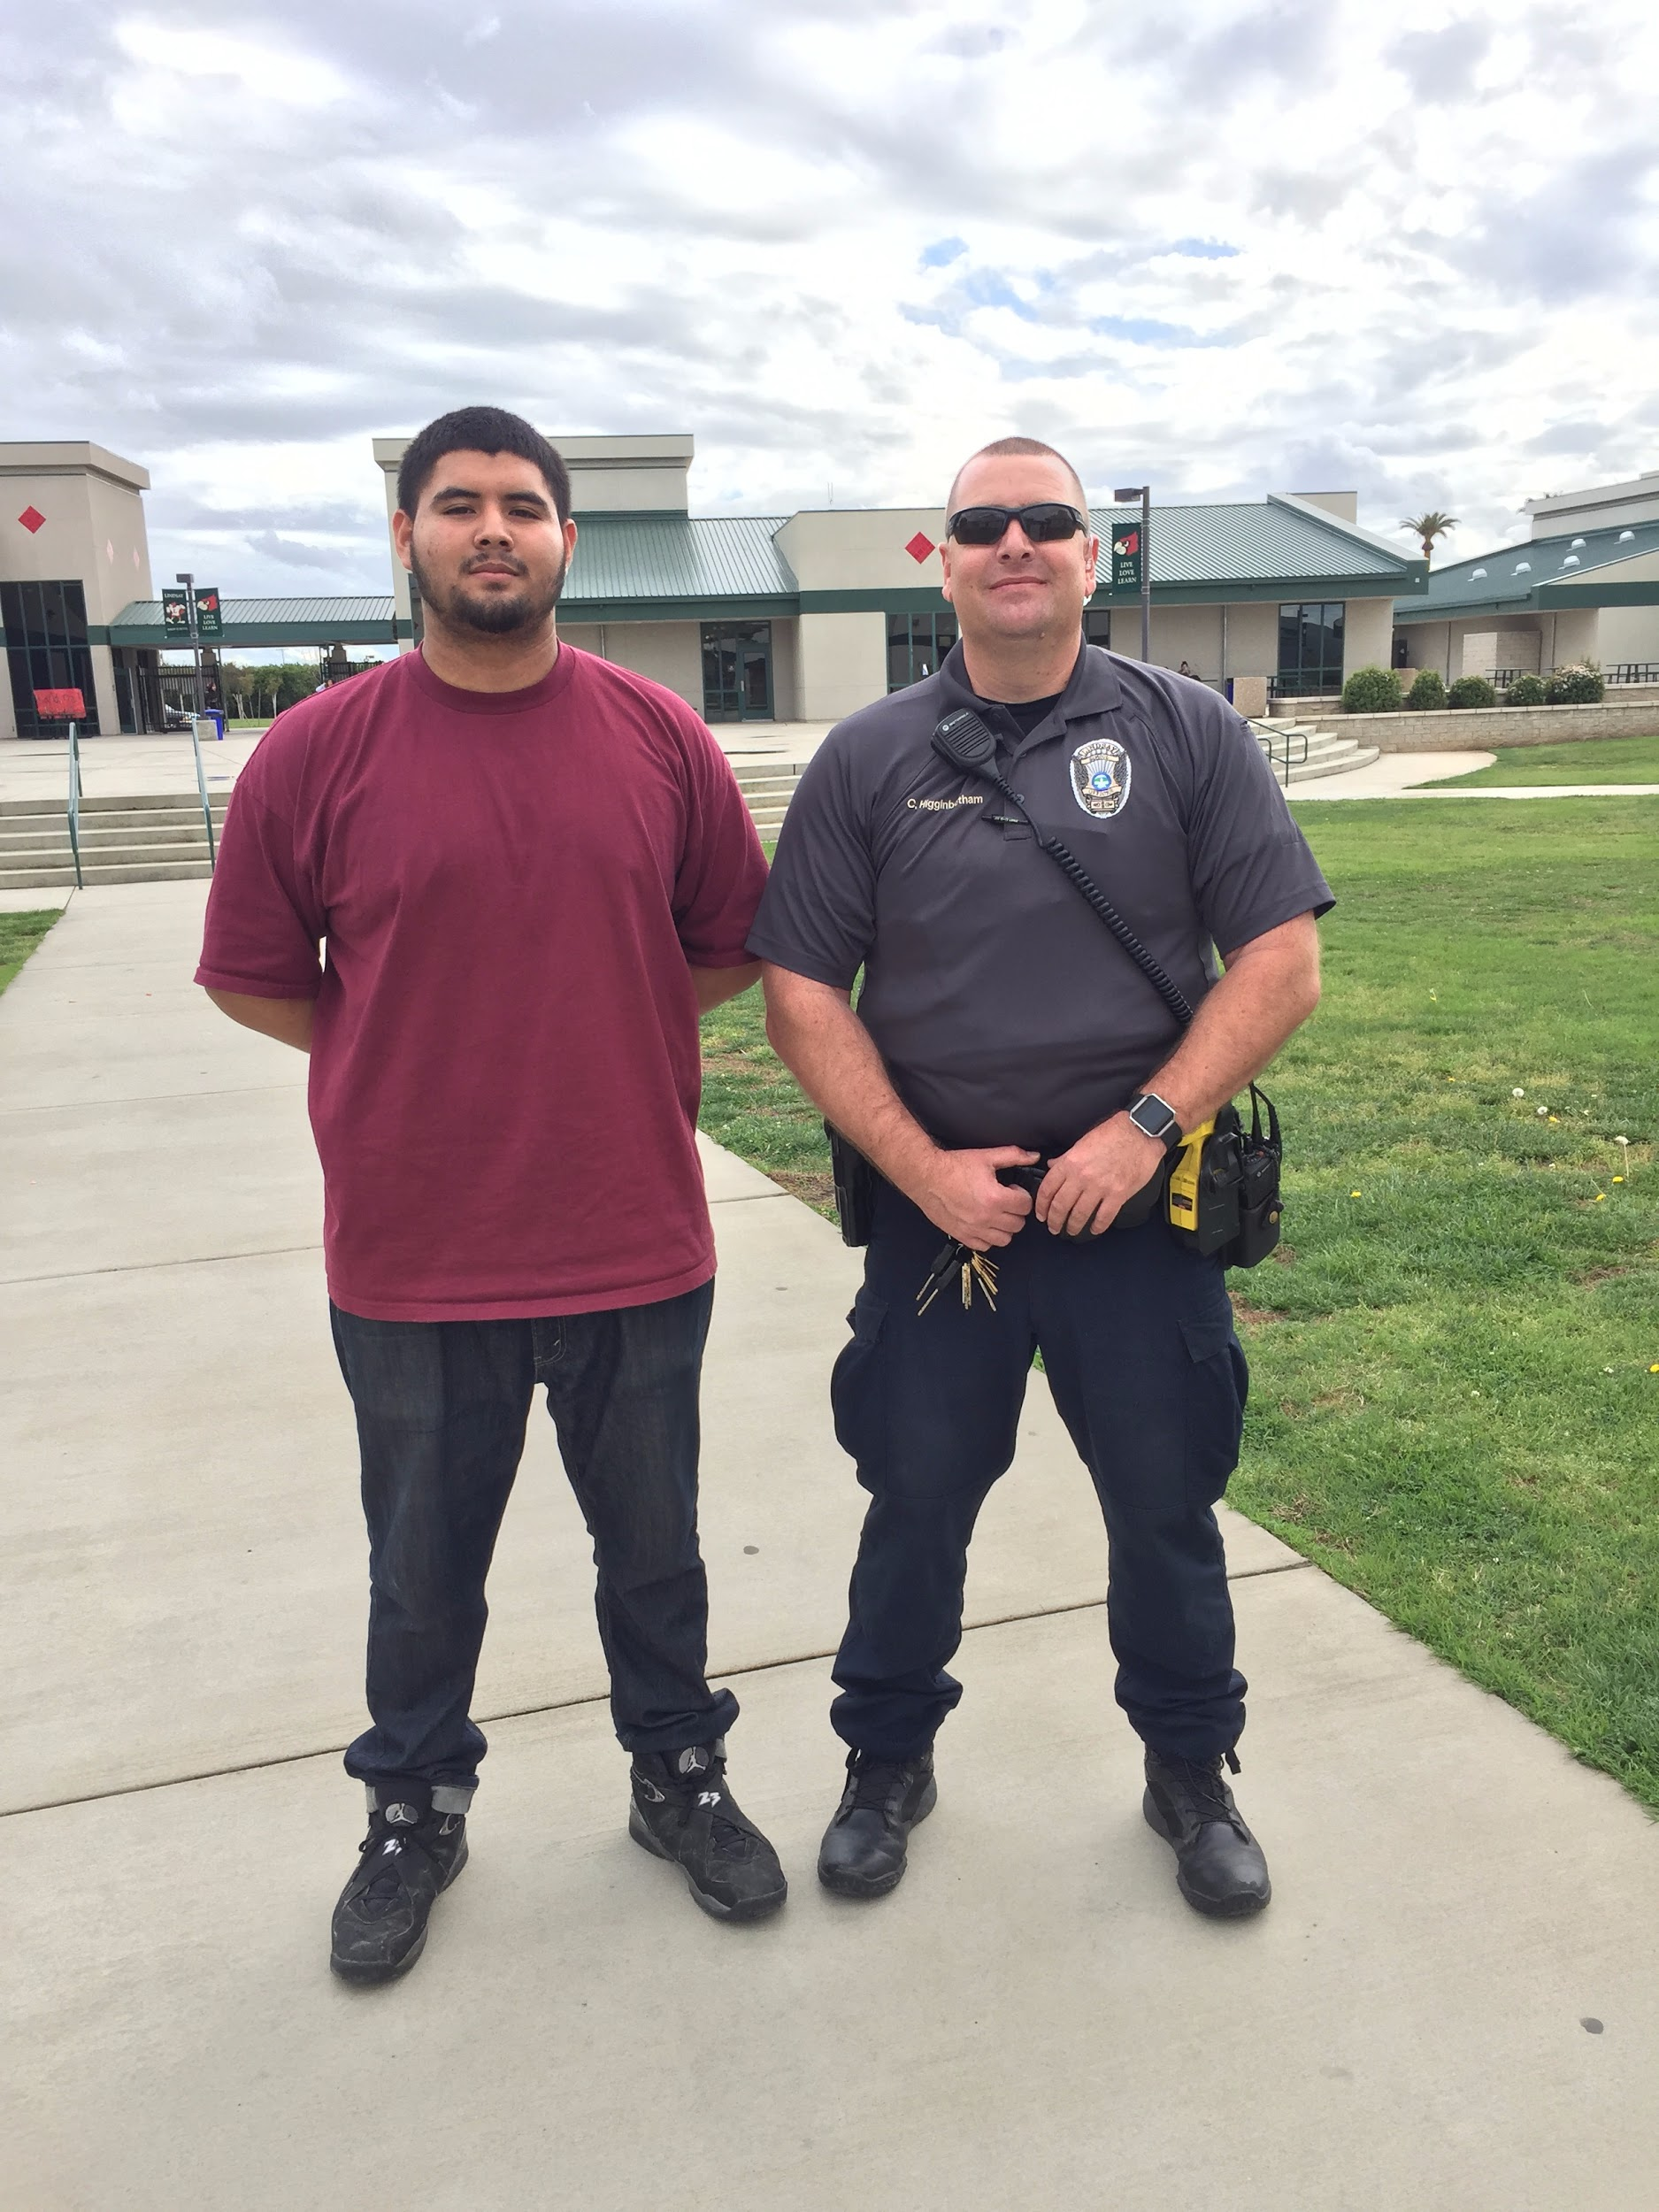
Job Shadow
Lindsay Police Department- being a policeman fits the way i am
Join the police academe at COS.
I found the way the officer explained his line of work helping and serving others interesting.
A memorable moment was when the officer explained the best part of his job was not just being a hero to the city but a hero to his wife and kids.
I see myself joining the police force.

Slide 5
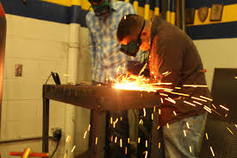
Pathway
Advance Ag Mechanics - was no accident.
More hands on
Not boring and always something to be doing around the shop
Welding, Cutting metal, working with tractors.
Taught me responsibility

Slide 6
Post High School Plans
College of the sequoias
Play football for 2 years and join the police academy
Group Studies
Then transfer to Fresno State

Slide 7
Leaving LHS
Redzone tends to help you more than teachers
Sports help you to stay on pace
Going to miss the good times as a freshman

Slide 8
Thank You
Questions?

